Slide 1
T-project RFP
Date:2021/2/22

Slide 2
Revision history
Revision | Content
V9 | Revised based on ALT email and Mantis on 2/20

Slide 3
1. Company Introduction

Slide 4
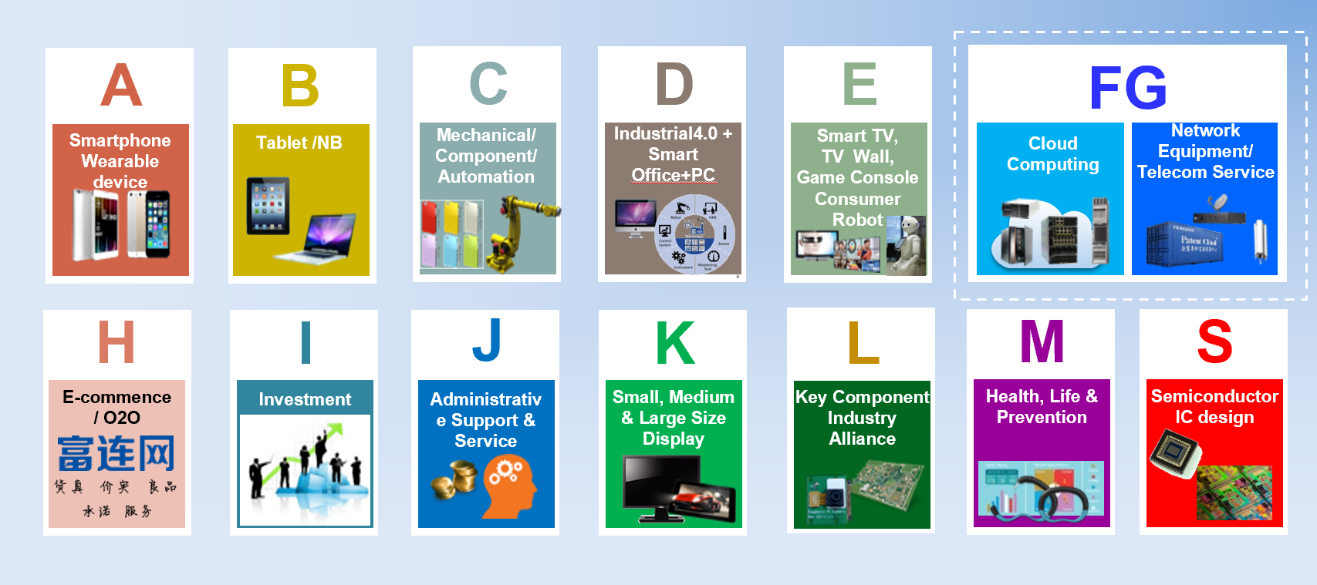
Foxconn Organization
(Fii)
Foxconn Confidential & Proprietary

Slide 5





Foxconn Industrial Internet (Fii) Company introduction
1.2.1. General Information
Automated Unmanned
Factories
Countries
Employees
Patents
Professionals
1.2.2. Business History
Foxconn becomes the governing unit of “Alliance of Industrial Internet”(AII) , “china mobile IoT alliance“ and customization industry alliance
Fii announced to build an “Industrial Internet Ecosystem”
Fii selected as 1 of 16 World Economic Forum’s (WEF)advanced manufacturing “lighthouses” factories.
Fii concept is born
2013
2015
2017
2019
Fii invested LUSTER, a machine vision company, and Digiwin, a digital solution provider, aiming to further ecology and expand capacity scope in Industrial Internet.
2014
2016
2018
2020
Set up a project team to prepare for industrial internet
Fii platform at Beijing Industrial Internet Alliance Conference
Fii listed on A share on Shanghai Stock Exchange
Foxconn Confidential & Proprietary

Slide 6
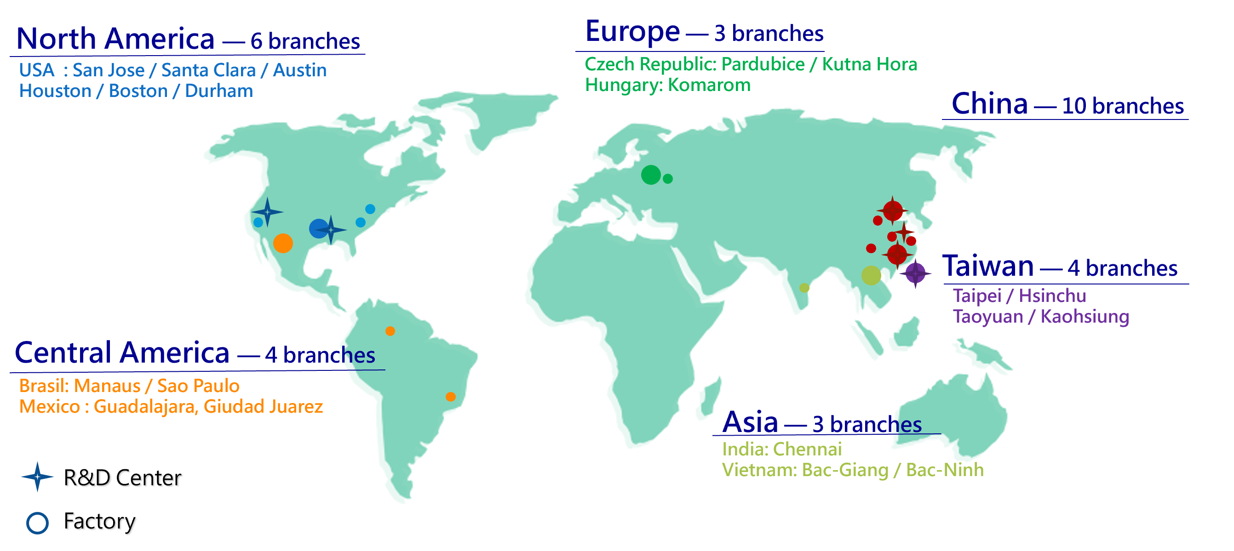
1.2.3. Fii major business sectors: FG Group Branch
North America － 3 branches
USA : San Jose / Santa Clara / Houston
China － 6 branches
Nanning / Long-Hua /
Song-Jiang / Guanlan /
Hang-Zhou / Chong-Qing
Brazil: Manaus / Sao Paulo
Mexico : Guadalajara / Giuded Juarez
Foxconn Confidential & Proprietary

Slide 7
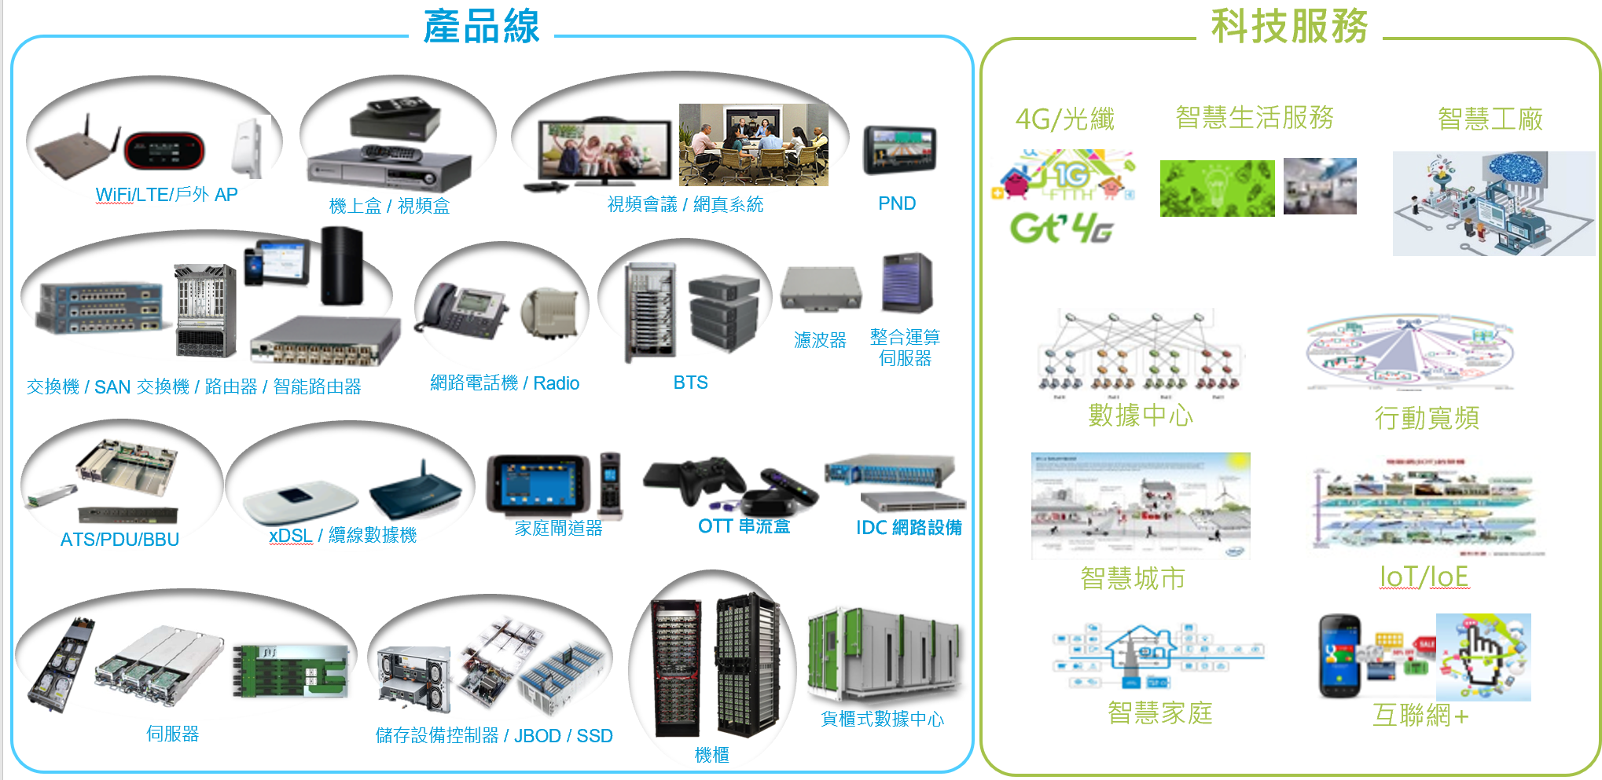
1.2.3. Fii major business sectors
Products
Services
4G/ Fiber
Smart Life
Smart Factory
Wifi/ LTE/ AP
STB
TV Conference
PND
Filter
Integration
Server
Switch/ Router/ Smart Gateway
IP Phone/ Radio
BTS
Data Center
Mobile Broadband
ATS/ PDU/ BBU
xDSL/ Modem
Home Gateway
OTT
IDC device
Smart City
IoT/ IoE
Server
Containerized Data Center
Smart Home
Internet +
Storage Controller/ JBOD/ SSD
Rack
Foxconn Confidential & Proprietary

Slide 8
1.2.4. Manpower/organization composition for T-project
PM/Sales/SW/HW
Kevin Liu/Peter Lan
BU Head, 25yr/27yr
Tiffanie
Lai
Sales,9yr
Henry
Chiou
RD PM,5yr
Rick
Chen
R&D head, 28yr
Jacky
Chiang
Software RDPL/ 19yr
Vincent Tung
Sales/PM head,21yr
River Wong
Chief Engineer, 18yr
Jim Chen
Senior Engineer,15yr
Jason Ling
Senior Engineer,12yr
Jerry Lin
Senior Engineer,15yr
Bcan Yeh
Senior Engineer,14yr
Sam Yang
Senior Engineer,4yr
Peter Chen
Junior Engineer,3yr
Brent Choi
Junior Engineer,1yr
Catherine Chen
Senior Engineer,6yr
Tom Lee
HW Lead/ 20yr
Fu-Chiang
Senior Engineer,14yr
Kerwin Chen
SW Lead/ 18yr
Sean Chiang
Hardware RDPL/ 19yr

Slide 9
1.2.4. Manpower/organization composition for T-project
ME
Layout
Compliance
Package
Andy Qin
Layout leader,16yr
Ming Rong
Senior engineer, 6yr
Enya
Senior engineer, 7yr
Jason Kung
Compliance leader, 19yr
Jonah Lee
Senior Engineer, 16yr
Wen Chao
Senior engineer, 8yr
Allen Chang
Package leader, 16yr
Lydia Liu
Senior engineer, 4yr
Charge Tseng
ME leader,20yr
Ace Liu
Senior engineer,5yr
Wilson Kao
SQA leader,20yr
James Kuo
Senior engineer,20yr
Bryan Yang
Senior engineer,12yr
Beca Ding
Junior Engineer,2yr
D.A. Wei
Senior engineer,8yr
HW QA
SQA
Kenji Chen
HWQA leader, 18yr
Tommy Chen
Senior engineer, 13yr
Leif Lin
Senior engineer, 12yr

Slide 10
1.2.4. Manpower/organization composition for T-project
CFT team from VN Factory
David Yin
MFG site manager,16yr
Ben Trinh
MFG Lead, 12yr
Bi
CFT NPI PM, 10yr
Nelly
CFT MP PM, 2yr
Lam Chu
PM lead, 11yr

Slide 11
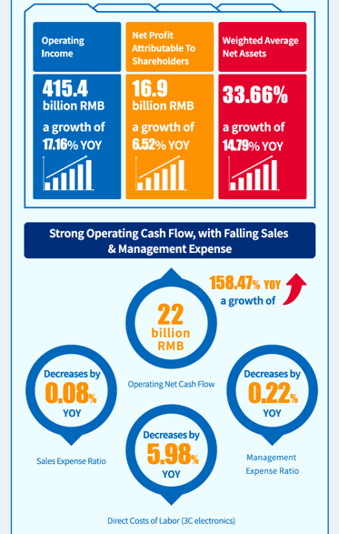
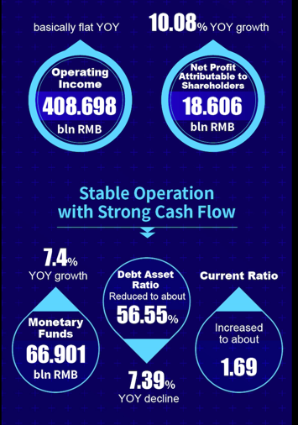
1.2.5. Business status for the last two years (sales, operating profit, net profit, etc.)
2018
2019
Reference link:
http://www.fii-foxconn.com/static/file/032919_content.pdf
Reference link:
http://www.fii-foxconn.com/static/file/%E9%95%BF%E5%9B%BE.jpg

Slide 12
1.2.6. Credit Evaluation sheet
2019
Lights-off Factory Shortlisted as one of the “Manufacturing Lighthouses Network” by World Economic Forum
2019 Excellent Solution of Industrial Internet APP
2019 Most Valuable brand A-share Company
One of 50 Smartest companies of the Year of 2019
2019 Tech-innovation Pioneer of A-share Listed Companies
Fii Cloud rated as one of Top 10 Cross-industry Industrial Internet Platform by MIIT in 2019 Charitable Contribution Award of A-share Listed Companies
2019 One-stop Precision Cutting Tool APP crowned the First China Industrial Internet Contest
2019 GBA Branded company Award with Five-star rating in CSR index
2019 Fii Included in the Three major indexes of HSSUS
2020
Fii Ranks 27 out of Top 500 Market Valued Listed Companies in the Year of 2019
2020 Rated as one of the “5G+Industrial Internet” Demonstrative Pilot Program by DIIT of Guangdong Province
2020 Fii Cloud Rated as one of Top 30 Notable Industrial Internet Platform of the Year
2020 Fii’s Board Rated as The Best Board of Directors
2020 Pioneer & One of Ten Excellent Solution in New Infrastructure and Industrial Internet
2020 Zhanlu Award-Most Dynamic Platform
2020 Top 100 Solution Provider in Industrial Internet
2020 Tool MicroCloud Rated as IoT Demonstrative Program by MIIT
2020 5G Industry Application and Demonstrative Program
2020 Rated as “Smart Manufacturing Demonstrative Pilot Program” by by DIIT of Guangdong Province
2020 Added to Top 100 Dynamic Enterprise Index
2020 Fii Included in the Three major indexes of HSSUS
2020 One of Top 50 Promising Enterprises of New Infrastructure in China
2020 Top 500 of New Economy in China
2020 One of Most Respectable Listed Companies in Shenzhen
2020 One of Top 100 Valuable Enterprises
2017-2018
Trusted Service Certificate of Industrial Internet Platform
2017 Excellent Application Case of Industrial Internet
2018 Excellent Industrial Internet Platform
One of 2018 China's Top 50 Big-Data Enterprises
2018 Pilot Demonstration Enterprise of Industrial Internet Platform Solution
2018 Intelligent Manufacturing Pilot Demonstration Enterprise
Enterprise of Industrial Internet Ecological Supply Resource Pool in Guangdong
Tianjin Smart Manufacturing and Industrial Internet Supply & Service Organization (First Batch) Platform Service Provider
The First Batch of Industrial Internet Application Benchmarking Units in Guangdong
TOP 10 out of China 50 Best Industrial Internet Enterprises
2017-2018 China Best 100 Internet Of Things
2018 TOP 15 in China Industrial Internet Platform Vitality List
2018 China Golden Great Wall Award for Smart Manufacturing
2018 Pilot Demonstration Project of Manufacturing “Entrepreneurship & Innovation” Platform
Reference : http://www.fii-foxconn.com/#/En/Home/About
Foxconn Confidential & Proprietary

Slide 13
1.3. ALT and Foxconn person in charge (main contact window)
Title | Name | Email
Sales/PM Head | Vincent | vincent.tung@foxconn.com
Sales | Tiffanie | tiffanie.ti.lai@fii-foxconn.com
RD PM | Henry | henry.chiou@mail.foxconn.com
R&D Head | Rick | rick.sj.chen@fii-foxconn.com
Software RDPL | Jacky | jacky.chiang@fii-foxconn.com
Hardware RDPL | Sean | sean.hy.chiang@fii-foxconn.com
Layout Leader | Andy | andy.x.qin@mail.foxconn.com
HWQA Leader | Kenji | kenji.hh.chen@mail.foxconn.com
SQA Leader | Wilson | wilson.fc.kao@fii-foxconn.com
ME Leader | Charge | charge.kc.tseng@mail.foxconn.com
Compliance Leader | Jason | jason.hj.kung@fii-foxconn.com
Package Leader | Allen | allen.wm.chang@fii-foxconn.com
MFG Lead | Ben | ben.trinh@fii-foxconn.com

Slide 14
3. List of Core Parts

Slide 15
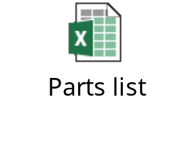
3. List of Core Parts
Please be noted 90% of parts are over 10WKs. The attached list doesn’t consider MLCC.
Part Name | MPN | Parts manufacturer | Reason for core parts
IC MPU 1.8/3.3V SMD FCBGA393 GP | S905X4-J | Amlogic | 1,2
IC PER 3.3V BLUETOOTH | RTL8761BTV-CG | Realtek | 2
IC DDR4 SDRAM 8Gb | K4A8G165WC-BCWE | Samsung | 2
IC DDR4 SDRAM 4Gb | K4A4G165WE-BCWE | Samsung | 2
IC eMMC 16GB | KLMAG1JETD-B041 | Samsung | 2
DSP | CX20921 | Conexant | 2
AMP | AD82128 | ESMT | 2
Compatible evaluation suggested parts
Part Name | No. 1 parts company | No. 2 parts company
IC DDR4 SDRAM 8Gb | Samsung | Hynix
IC DDR4 SDRAM 4Gb | Samsung | Hynix

Slide 16
4. Propose equipment technology and characteristics

Slide 17
4.2.1 Equipment Model Name
ALT check

Slide 18
4.2.2 Structure and form of proposed equipment-block diagram
Reset IC
Crystal
24MHz
DDR4
SDRAM
1G*2+512MB*2
eMMC
Flash
16GB
Rear Panel
Front Panel
32bits
8bits
Class D Amp
Speaker
4Ω, 3W
GPIO
Power LED
S905X4
SoC
RST
I2C
GPIO
Internet LED
SPDIF
Optical Connector
SPDIF Interface
I2S
GPIO
Voice LED
Left Panel
AI Speaker
GPIO
Power on/off button
HDMI
Connector
(HDMI2.1)
TMDS/DDC_I2C/CEC/HPD
GPIO/IR IN
IR receiver
GPIO/IR out
IR Blaster
Ethernet TX/RX
RJ45
Connector
Serial Flash
Crystal
24MHz
SPI
DC Jack
12V
I2S
CX20921
Voice Processor
DAC + DSP
CLK
MIC L IN
Data
5V
GPIO
GPIO
GPIO
UART
PCM
I2C
12V
Power Block
DC-DC
VDD_EE
MIC R IN
Power Switch
VDD_CPU
VCC_3.3V
BT5.0
IC
PCB
Antenna *1
DDR4_1.2V
USB TX/RX/D+/D-
VCC_3.3V
VCC_1.8V
VCC_3.3V
LDO
eMMC_VDDQ
VCC_3.3V
LDO
DDR4_2.5V
LDO
Crystal
20MHz
USB 2.0
CH UP/Down
Vol. Up/Down
MIC
On/Off

Slide 19
4.2.2 System power block and power consumption chart (Maximum 11.65W)
56mA
MP1653 (3A)
0.8V/773mA
12V/
970.7mA/
11.65W
VDD_EE
Efficiency = 92%
73.5mA
1.05V/773mA
MP1653 (3A)
VDDCPU
Efficiency = 92%
eMMC
180mA
3.3V/603mA
3.3V/30mA
4 ohm
/3W
MP1657 (2A)
Efficiency = 92%
1.8V/87mA
Class-D
AMP
3.3V/97mA
LDO
FP6188-18S5
1.8V/10mA
3.75W/
312.5mA
VDDIO_BOOT
Efficiency = 80%
3.3V/144mA
VDDIO_3V3
3.3V/49mA
Voice
Processor
Efficiency = 92%
265mA
MP1657 (2A)
3.3V/38.5mA
BT
15mA
LED x3
3.3V/172mA
LDO
FP6188-18S5
1.8V/172mA
AVDD18
500mA
USB2.0
3.3V/72mA
LDO
FP6188-25S5
65mA
HDMI
VDDQ
5mA
Efficiency = 85%
2.5V/72mA
S/PDIF
83.6mA
1.2V/711mA
MP1657 (2A)
DDR4*4
Test Condition:
4K60Hz HDMI output, Wow Fish 3D Game (referred from AML S905X4 AH212 Power Consumption Test Report )
Speaker = Max. volume

Slide 20
4.2.2 System power block and power consumption chart (Normal 8.39W)
62.5mA
MP1653 (3A)
0.8V/844mA
12V/
699.5mA/
8.39W
VDD_EE
Efficiency = 90%
25.5mA
0.841V/327mA
VDDCPU
MP1653 (3A)
Efficiency = 90%
eMMC
157.2mA
MP1657 (2A)
3.3V/520mA
3.3V/24mA
4 ohm
/2.1W
1.8V/70mA
Efficiency = 91%
3.3V/80mA
2.625W/
218.8mA
Class-D
AMP
LDO
FP6188-18S5
1.8V/10mA
VDDIO_BOOT
Efficiency = 80%
3.3V/131mA
VDDIO_3V3
3.3V/49mA
Voice
Processor
Efficiency = 91%
148.8mA
MP1657 (2A)
3.3V/38.5mA
BT
15mA
LED x3
3.3V/168mA
LDO
FP6188-18S5
1.8V/168mA
AVDD18
300mA
USB2.0
3.3V/30mA
LDO
FP6188-25S5
5mA
HDMI
VDDQ
5mA
Efficiency = 84%
2.5V/30mA
S/PDIF
86.8mA
1.2V/729mA
MP1657 (2A)
DDR4*4
Test Condition:
4K60Hz HDMI output, AV1_4K_60fps
Streaming from PC, Eth on, wifi off (referred from AML S905X4 AH212 Power Consumption Test Report )
Speaker = 70% volume

Slide 21

4.2.2 Structure and form of proposed equipment-MIC & SPK Signal Flow Block Diagram
I2C
S905X4
SoC
Class D Amp
BCLK
BCLK
LRCK
LRCK
Speaker
4Ω, 3W
DATA
DIN
Playback Audio
DOUT
AEC reference
CX20921
DIN
BCLK
LRCK
DATA
Voice Process
DATA
BCLK
BCLK
CLK
MIC L IN
LRCK
LRCK
Data
MIC R IN
I2C

Slide 22
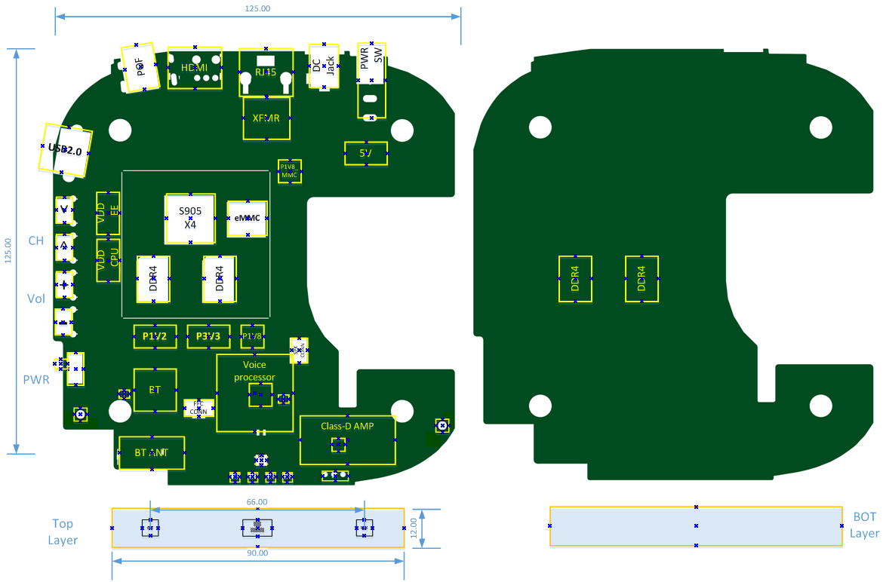
4.2.2 Structure and form of proposed equipment- Layout placement

Slide 23
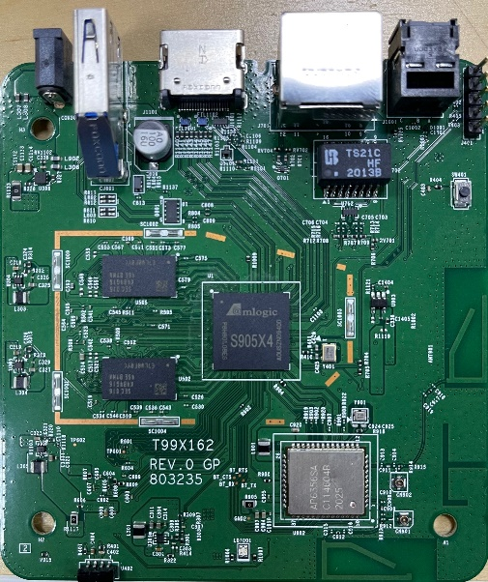
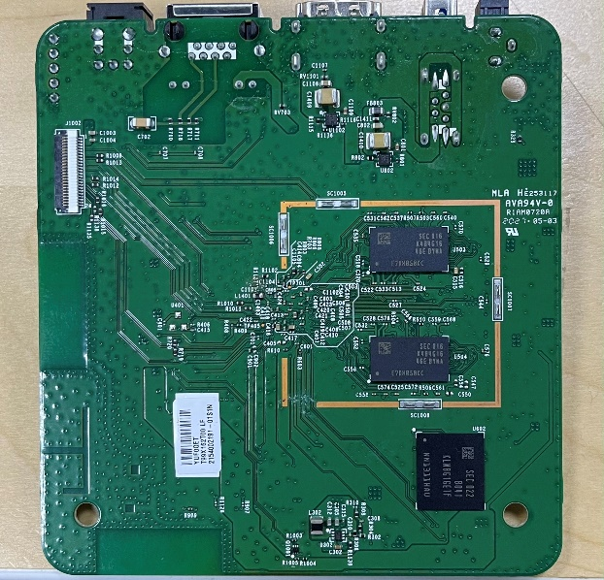
4.2.3 Equipment components (including detailed photos)
4K OTT Board
Technical Specification
Chipset | Memory
AML S905X4 Quad-Core Cortex-A55 ARM Mali-G31 MP2, 850MHz | 2 GB DDR3 8 GB eMMC flash
Interface | Features
-HDMI 2.1 @ 4Kp60 output x1, HDCP 2.2 -USB 3.0 Type A x1 -RJ-45 x1; 10Mbps / 100Mbps -Optical S/PDIF x 1 -IR receiver x 1 -LED for power on/off indication -DC jack for 5V @ 2A DC input | Main stream box for HEVC/4K video HLS/MS Smooth Streaming/MPEG-DASH, HDR 10/ HLG/Dolby Vision Google casting support BT Voice control Preload apps for TV services Over-The-Air image upgrade
Networking | Remote Control
Wi-Fi 802.11 ac/a/b/g/n 2x2 dual band 10/100 Base-T Ethernet Bluetooth 5.0 w/ BLE | BT5.0 or IR based RCU
Operating System
Android 11 Widevine Level 1/PlayReady DRM support
Highlight
Operation environment | Temperature 0 ~ 40°C Humidity 10% ~ 90% relative humidity
Wi-Fi 2.4/5GHz 2T2R Connection | Support 802.11 ac/a/b/g/n Data rate up to 866Mbps
Power adapter | 100~240VAC input, 5V/2A DC output
Fii have kicked off several 4K OTT projects based on S905X4.
23
Notes:
1. 一組 S/PDIF
2. 兩組 USB
3. 一組 Composite
23

Slide 24
4.3.1. S/W function block diagram and function description for each block
Android Applications
KT Operator Tier App
Google Apps
Activity Manager
Linear Service
Bound Apps
Unbound Apps
Service
3rd Party Apps
OTT Apps
Voice Assistant Activity
Genie Apps
Android Framework
KT TV Core
Android Media / System
and other Services
ExoPlayer / Media Framework
HW Control
Media CAS API
UCEMS Client
SW Client
KT Voice Assistant Service
Firmware
Base Libraries
SoC Media SDK
(Libraries)
KT CAS
(Libraries)
Android Native
(Libraries)
HAL (Audio, Graphics, Network, …etc)
Linux Kernel (SoC SDK)
Drivers
Modules
…
SecureOS
DRM Lib

Slide 25
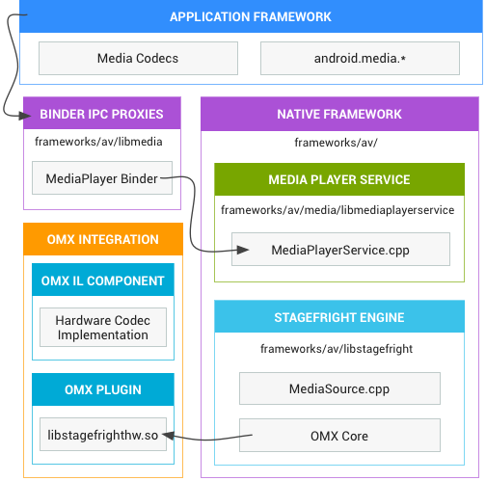
4.3.1. S/W function block diagram and function description for each block
Android Media Framework Architecture
Application Framework
At the application framework level is application code that utilizes android.media APIs to interact with the multimedia hardware.
Binder IPC
The Binder IPC proxies facilitate communication over process boundaries.
Native Multimedia Framework
At the native level, Android provides a multimedia framework that utilizes the Stagefright engine for audio and video recording and playback.
OpenMAX Integration Layer (IL)
The OpenMAX IL provides a standardized way for Stagefright to recognize and use AML hardware-based multimedia codecs called components.
AML provide an OpenMAX plugin named libstagefrighthw.so.
This plugin links Stagefright with AML’s codec components, which is implemented according to the OpenMAX IL component standard.
AML
AML

Slide 26
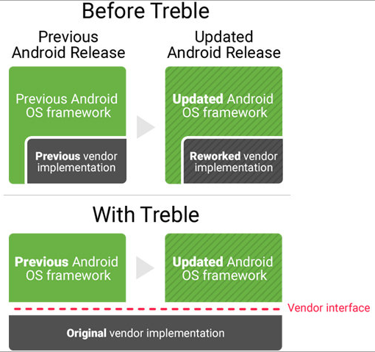
4.3.1. S/W function block diagram and function description for each block
Android Version-up and OTA Upgrade Flow
OTA Upgrade Flow
OTA Preparation
SDS Client Start
Download and store OTA file
Build/Release new version
Connect to OTA Server
Reboot to recovery
Check version
Need to upgrade
Generate OTA file
Execute commands to update files in recovery
Reboot to normal system image
Google Project Treble:
In Android 8.0 and higher, a new stable vendor interface provides access to the hardware-specific parts of Android, so device makers can deliver new Android releases simply by updating the Android OS framework—without additional work required from the silicon manufacturers
Upload to OTA Server
Up to date
OTA Process finish

Slide 27
4.3.1. S/W function block diagram and function description for each block
Incremental OTA
The same update flow with standard OTA
Maybe 1/10 or less OTA file size than standard OTA
Incremental OTA files: applied to specific FW only
e.g. OTA_13: applied to FW 1, upgrade to FW 3
OTA_23: applied to FW 2, upgrade to FW 3
+
=
FW 1
OTA_13
FW 3
+
=
FW 2
OTA_23
FW 3
Apply wrong incremental OTA file may cause the device unusable
+
X
=
FW 2
OTA_13

Slide 28
4.3.1. S/W function block diagram and function description for each block
Secure Image Signing and Secure Boot Flow
Build
environment
Signing tools
Result
Hash+signature
Unsigned images
secure boot key
(HW root key)
Signed images
Signing flow of secure boot
Start
Bootloader
OK
Bootloader
Security certification (recognized lab)
Amlogic S905X4: Pass certification in Riscure lab
Signing tools
The image signing tools would be provided by Amlogic
Verify signature of boot image
(HW root key)
Start to run image
Fail
Bootloader
Stop to run image
Verification flow of secure boot

Slide 29
4.3.1. S/W function block diagram and function description for each block
IP Address Setting (DHCP)
If there is no response after sending a DHCP message, the retransmission interval should follow the criteria below.
  When the Discover/Offer is not received, the discover message is transmitted at '0, 4, 8, 16, 32 seconds' for the first minute, and at a certain period (15 seconds) after 1 minute. However, the period may be changed by requesting a service.
  When Request/ACK is not received, the request message is transmitted in 0, 1, 2, 2 seconds and then the discover message is transmitted.
  When ACK is not received at T1 Time (1/2 time point), a request message is transmitted in 4, 8, 16, 32 seconds and then waits until the next T2 Time.
  When ACK is not received at T2 Time (7/8 of the release time), the request message is transmitted in 4, 8, 16, and 32 seconds, and then the discover message is transmitted after waiting until the next lease time.
STATE
CLIENT
DHCP SERVER
1
Discover
2
Offer
3
INITIALIZATION
Request
Ack
4
EXTEND ADDRESS LEASE
5
Request
1/2 OF LEASE
Ack
6
RENEWING
7
Request
7/8 OF LEASE
8
Ack

Slide 30
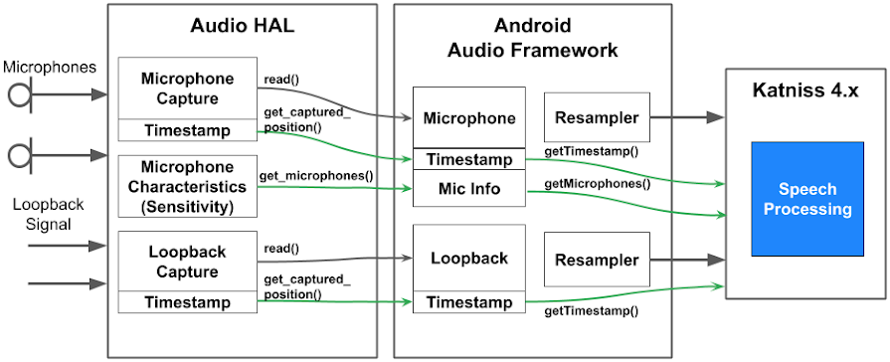
4.3.1. S/W function block diagram and function description for each block
Google Far Field Voice Pipeline
It must design an audio HAL that meets Google far field speech requirements.
A secured audio device source, AUDIO_DEVICE_IN_ECHO_REFERENCE from Android Framework, is used to pipe secured loopback audio sources such as app content player (YouTube) and external inputs (HDMI-in).
Design consideration and conflict: Current MIC input data passes through the Conexant for Giga Genie but Google FFV design doesn’t require extra Conexant chip, so it needs Google/ Amlogic to discuss with KT for how to enable dual FFV feature.

Slide 31
4.3.2 List of OpenSource SW licenses
Items | License
Android | Android Apache License 2.0 for userspace software, GNU GPL v2 for the Linux kernel
ffmpeg | GNU GPLv2,GPLv3
exfat | GNU GPLv2
libtiff | BSD-like license
ntfs-3g | GNU GPLv2

Slide 32

4.4 Function and performance – S905X4 Benchmark Test Report
Project | SC2_S905X4_AH212 Android Q
Firmware Version | http://firmware.myamlogic.com/shanghai/image/android/Android-Q/Android_TV/patchbuild/2020-08-24/ohm-
 | userdebug-android32-kernel64-GTVS-57/
 | http://firmware.myamlogic.com/shanghai/image/android/Android-Q/Android_TV/patchbuild/2020-08-26/ohm-
 | userdebug-android32-kernel64-GTVS-61/
Type |  |  | 2020/8/27
Benchmark |  | Project | SC2-S905X4
 |  | Hardware Spec | AH212+2G Memory
 |  | Software Spec | Android Q
 |  | CPU MAX | 2.0GHz
 |  | GPU MAX | 846MHz
 |  | DDR Frequency | DDR4 1584MHz
 |  | System Spec. | 32bit
 |  | Screen Resolution | 3840*2160
 |  | Time | 1st
Antutu v8 | Total Score |  | 95323
 | CPU | Total | 35508
 |  | CPU Mathematical | 4931
 |  | CPU Common | 7401
 |  | CPU Multi-Core | 23176
 | GPU | Total | 10820
 |  | Terracotta | out of memory
 |  | Coastline | 3161
 |  | Refinery | 7659
 | Memory | Total | 33272
 |  | RAM Access | 17582
 |  | ROM APP IO | 1332
 |  | ROM Sequential Read | 2803
 |  | ROM Sequential Write | 675
 |  | ROM Random Access | 10880
 | UX | Total | 15723
 |  | Data Security | 3806
 |  | Data Processing | 4677
 |  | Image Processing | 2441
 |  | User Experience | 4799

Slide 33
4.5.3 Features and excellence of the proposed solution
Main stream box for HEVC/4K video
HLS/MS Smooth Streaming/MPEG-DASH,
HDR 10/ Dolby Vision
Google casting support
BT Voice control
Preload apps for TV services
Over-The-Air image upgrade
Netflix NTS certificated
4.5.4 Eco friendly functions and technologies
Passive standby mode under 1W

Slide 34

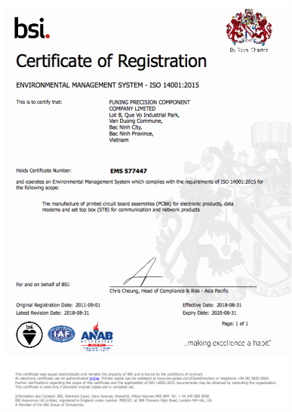
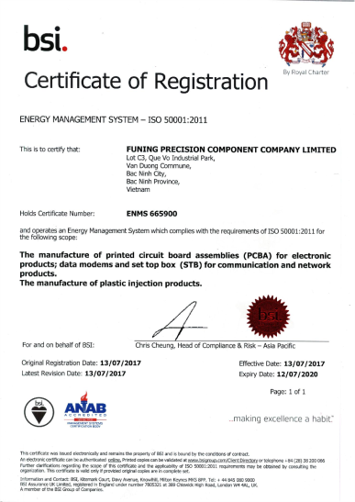
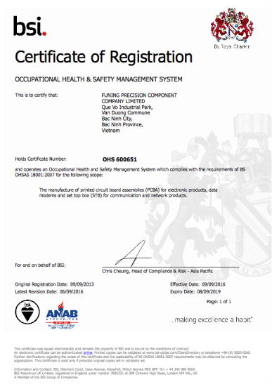
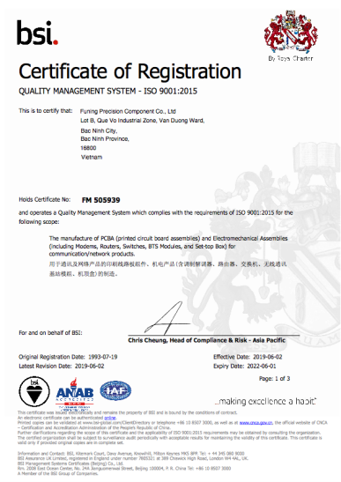
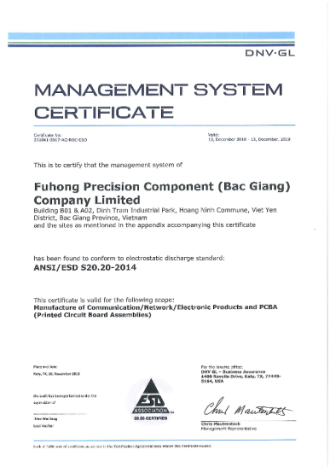
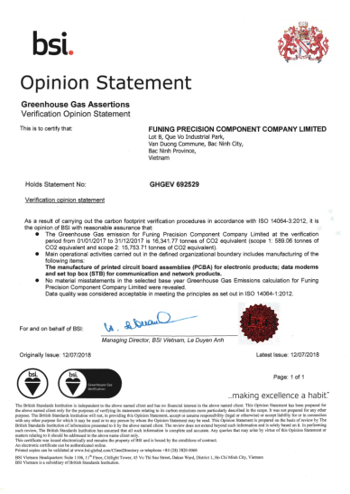
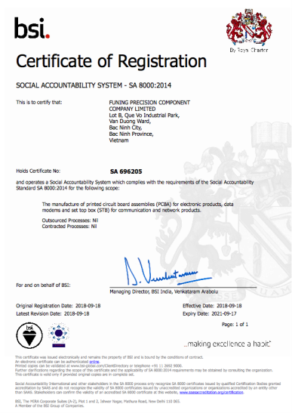
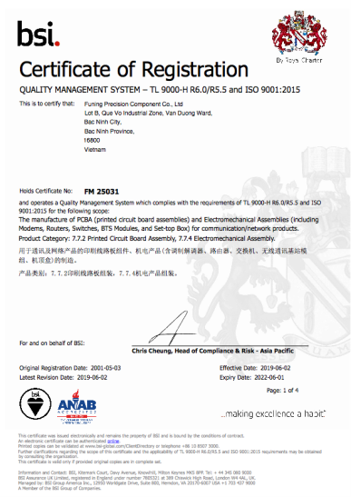
4.6.1 certification and patents
ISO140001
ISO50001
OHS600651
ISO9001
ESD
ISO14064
SA8000
TL9000

Slide 35
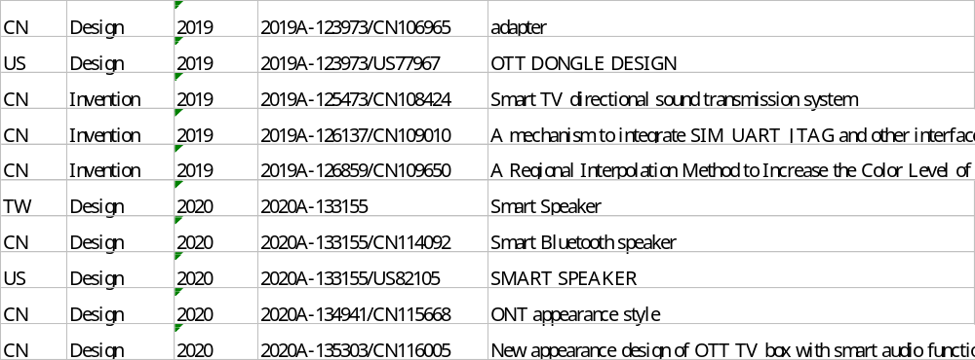

4.6.1 certification and patents
There are 188 OTT & Smart speaker related patents (including invention patent, utility model patent and design patent)
Below is the latest 10 patent list and the complete information please refer to the attachment

Slide 36








4.6.2 Reports of testing institutions
HWQA Reliability Test Items
Climatic Test
Thermal Profile test
Cold / Hot Start Test
Continuation of temperature cycle
EDVT
Temperature and humidity cycles test
High Temperature & Humidity Test (Op)
Operational Temperature Range
Power on/of f with Temp.
Quicky Power on/off Test
RDT Test
MTBF Prediction
HALT Test
Reliability
Mechanical Test
Vibration Test Random (Op)
Shock test (Op)
Label Adhesion Test
Abrasion Resistance of Label Test
Logo/Printing Abrasion Test
Non-operating drop test
Salt Spray Test
Connector Life Test
Button Life Test
Reliability Standard:
IEC60068 for Environmental
ISTA-2A for Package test
3rd Party Lab.: Orange color
Package Test
Temperature and Humidity Test
Static Compression Test
Random Vibration Test
Free Fall Drop Packaged
Fix Displacement Vibration Test

Slide 37
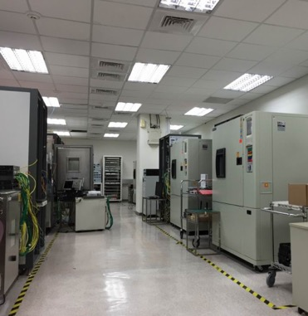

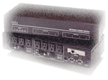

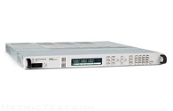
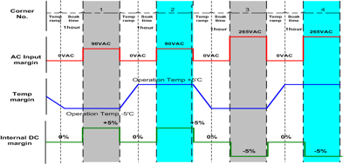
4.6.2 Reports of testing institutions
HWQA Capabilities – EDVT
EDVT
Electrical Design Verification Test
Verify the hardware design by exposure of the product to wider temp & voltage margining.
Temperature Margin: Min Op. Temp – 5’C ~ Max Op. Temp + 5’C
Voltage Margin DC: All Power Rail +/- 5%
Voltage Margin AC: 90VAC /47Hz & 264VAC / 63Hz
IXIA
Power Cycle Box
DAQ
EDVT Lab
Power Supply

Slide 38
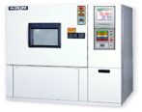


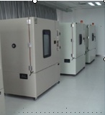

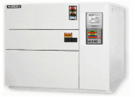
4.6.2 Reports of testing institutions
HWQA Capabilities – MDVT
MDVT
Mechanical Design Verification Test
ＭＤＶＴ
MDVT is comprised of dynamic (mechanical) and environmental tests. These combination of op. and non-op. tests.
Thermal Profile Measurement
Environmental Test – High/Low Temp/Hum., Altitude, UV, Rain, Dust, Salt spread…etc.
Mechanical Test - Vib & Shock, Drop, button life, cable..etc
Package Test – ISTA-2A, 3A
Product Reliability: MTBF Prediction/ demo., thermal shock…etc.
Test to failed – HALT, HASS
Thermal Chamber
Drop Tester
Shock Tester
Env. Chambers
HALT
Vib. Test for Rack
Thermal Shock

Slide 39


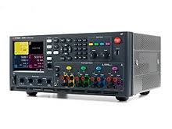

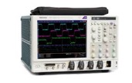
4.6.2 Reports of testing institutions
HWQA Capabilities - SI Meas.
SI
Signal Integrity Measurement
A dedicated team to work on a set of measures of the quality of an high-speed electrical signal.
IEEE802.3 10M/100M/1G/10G/2.5G/5G/40G/100G/400G Compliance Test
SFP+/QSFP+/QSFP+100 Compliance Test
DDR I/ II/ III/IV/IVLE Signal Test
UDB3.1/HDMI/PCIe/SATA
DC/DC, AC/DC, PoE
Clock Phase Noise
….etc.
Keysight 86100D
DPO71604C
Keysight N6705C
MSO72304DX
400G SI Test
Keysight 86100D

Slide 40
4.6.2 Reports of testing institutions
MDVT
SI
HWQA Test
EDVT
Test
Standards
IEEE 802.3
SFF-8431
JEDEC 79-4A
IEC 60068-2
MIL-STD
NEBS GR-63 CORE
Telcordia SR-332
ISO7779
ISTA – 2A

Slide 41
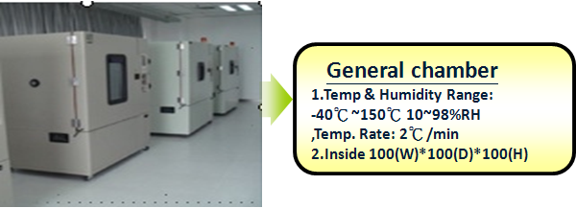
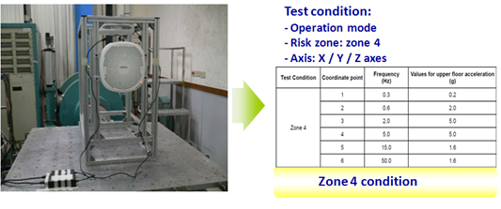
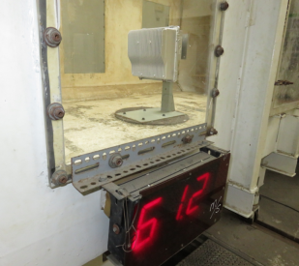
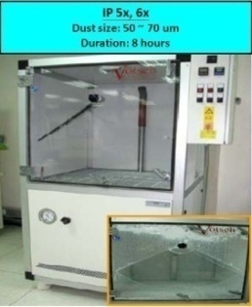
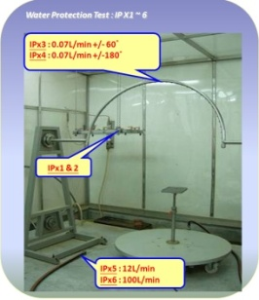
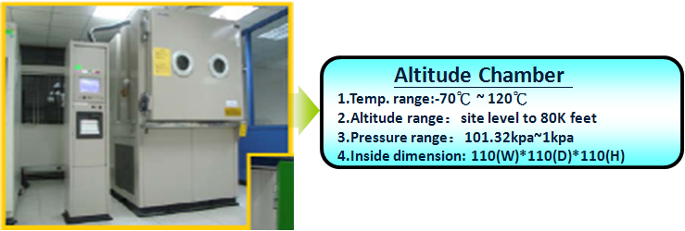

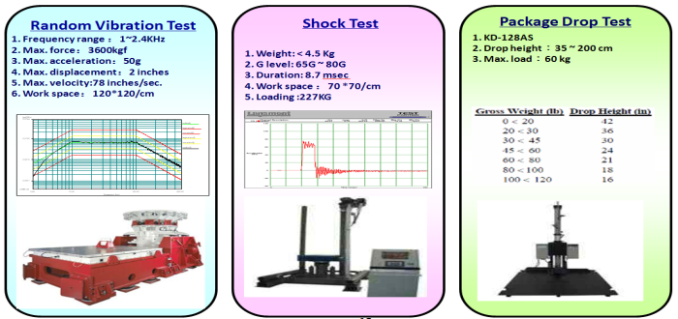
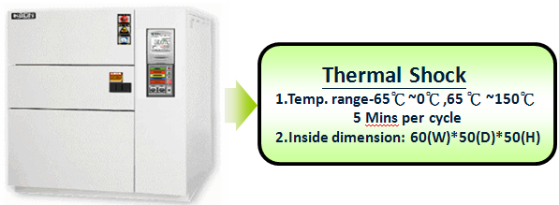

4.6.2 Reports of testing institutions
HWQA Capabilities
(1) General chamber:
(4) Earthquake (zone 4 level):
(7) Wind loading test: 61.2 m/s (wind level 17: strongest typhoon)
(5) Dust & water protection (IP65):
(2) Altitude chamber:
(8) Salt fog test: 5% salt, 35℃
(3) Thermal shock:
(6) Package test machine:
(9) Solar test:1120 w/m², 55 ℃

Slide 42
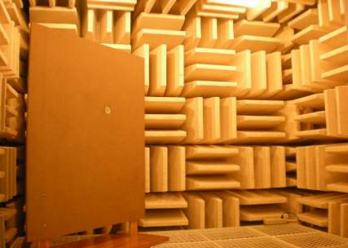
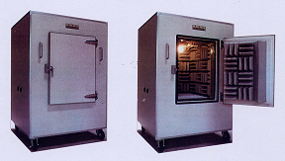
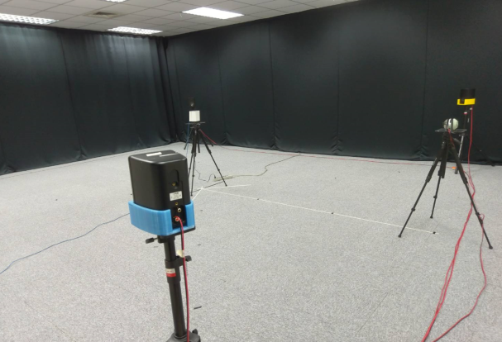
4.6.2 Reports of testing institutions
Acoustic Test Equipment
Anechoic Chamber
Anechoic Box
Listening Room
Inner Dimension : 2 m(L)×2 (W)×2m(H)
Background Noise : < 15dBA
Cut-off Frequency : 125 Hz
Inner Dimension : 0.6 m(L)×0.58 (W)×0.85(H)
Background Noise : < 25dBA
Cut-off Frequency : 120 Hz
Inner Dimension : 7 m(L)×6 (W)×3(H)
Background Noise : < 30dBA
Reverberation time between 0.2 s and 0.7s
Bigger than ETSI test room

Slide 43
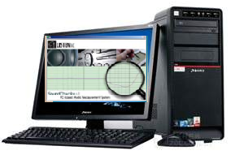

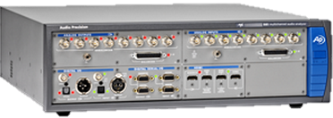
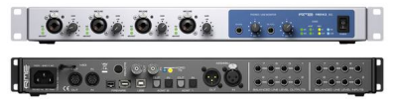
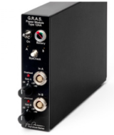
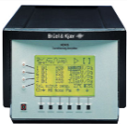
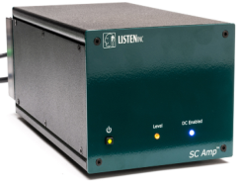
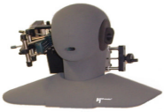

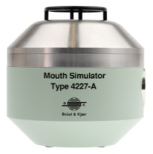
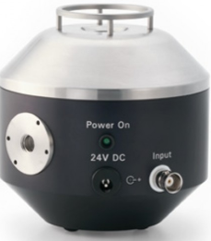



4.6.2 Reports of testing institutions
Acoustic Test Equipment
Speaker & Microphone Test equipment
Head Acoustics ACQUA
(Speech Quality
Analysis System)
APx585
Soundcheck listen with RME soundcard
Head Acoustics MFE VIII
(VoIP SIP Ref. GW)
Microphone Calibrator
B&K 4231 / GRAS 42AB
GRAS 12AA Microphone power module with Gain
B&K Nexus
Conditioning Amplifier
SCAmp
Audio Test Amplifier
Head Acoustics
HMS II.3 HATS
Head Acoustics MFE VI.1
(Analog Front-end)
Power Amplifier
KMT DC3
B&K 4955 / 4191
GRAS 26AM/ 40HL
B&K 4227
Mouth Simulator
GRAS 44AA
Mouth Simulator
B&K 4128c
HATS
Notes:
— Adobe Audition (Cool Edit): It is a tool to generate, edit, and output various audio signals for Electro-Acoustics testing.

Slide 44





4.6.2 Reports of testing institutions
Speaker & Microphone(Analog & Digital) Test
APx585
Speaker test Items
Sound pressure level
Frequency response
Phase
Total harmonic distortion
Total harmonic distortion with noise
SNR
Microphone Pre-amplifier
Speaker
Microphone
Power Amplifier
Anechoic Chamber
Microphone test Items:
Frequency response
Sensitivity
Polar plots(Directivity)
Linearity
Noise floor
Analog or Digital(PDM) microphone
Record
Anechoic Chamber

Slide 45



4.6.2 Reports of testing institutions
Acoustic Noise Test
Measure frequency range from 20Hz to 20KHz
Measure the sound pressure level with “A-weighting “ which approximates the response of the human ear to sounds of medium intensity
Test Items
  Sound Pressure Level
  Low-level measurement
  FFT and Real Time analysis
Head Acoustics MFE VI.1
(Analog Front-end)
B&K Nexus Conditioning Amplifier
Apx 585

Slide 46


4.6.2 Reports of testing institutions
Amazon ALEXA voice service test (Background noise simulation)
Amazon ALEXA voice service test Items
Wake-word False Rejection Rate
Response Accuracy Rate (RAR)
Wake-word Detection Delay (Latency)
Wake-word False Alarm Rate (FAR)
Power Amplifier
KMT DC3
Inner Dimension : 7 m(L)×6 (W)×3(H) (larger than ETSI request 3.5 m(L)×4 (W)×2.5(H))
Background Noise : < 30dBA
Reverberation time between 0.2 s and 0.7s
Bigger than ETSI test room

Slide 47



4.6.2 Reports of testing institutions
Google ART Test Equipment & item
Google ART Lab setup requirements
Listening chamber (meet the requirements of ETSI 202-396-1)
Background noise system(Canton xl plus noise speaker*4 & power amplifier KMT DC3 )
Simulated users(HEAD ACQUA Acoustic HATS 、B&K mouth simulator)
Calibration and control system (Listen Inc SoundCheck version 17)
Google ART test Items
Wake-word False Rejection Rate
Response Accuracy Rate (RAR)
Wake-word Detection Delay (Latency)
Wake-word False Alarm Rate (FAR)
Power Amplifier
KMT DC3
Listen Inc SoundCheck version 17 with Mac OS
Inner Dimension : 7 m(L)×6 (W)×3(H)
Background Noise : < 30dBA
Reverberation time between 0.2 s and 0.7s
Bigger than test room(ETSI 202-396-1)

Slide 48
























OTT Box Test Environment
4.6.2 Reports of testing institutions
Subjective Test
Video Streaming
TV Sets
Sony, Panasonic, Toshiba, Sharp ...
Internet
Speakers
HDMI
Composite
Component
Traffic Jitter/Delay/ Drop
- Shunra Storm
Dolby AV Receiver
Ethernet
Ethernet
Peripheral Test
WiFi
802.11 b/g/n/ac
WEP/WPA/WPA2
AP
Remote
Controller
Ethernet
OTT Box
Objective Test
Audio Analyzer
- AP APX585 & AP2722
Picture Analyzer
- Video Clarity ClearView
HDMI Protocol/CEC Analyzer
- Quantum Data 980 / 882E
Digital Serial Analyzer
- TEK DSA71604B

Slide 49



4.6.2 Reports of testing institutions
CTS Test (Compatibility Test Suite)
Internet
Base Station
Wireless
The CTS is an automated testing suite
The CTS runs on a desktop machine and executes test cases directly on attached devices or an emulator

Slide 50
5. Supply Records

Slide 51
5.1. STB supply performance of domestic and foreign paid broadcasting (IPTV/CATV/Satellite)
Fii works with worldwide 1st Tier Brand companies: Google, Amazon, Roku, Technicolor for worldwide carriers.
Over 15 million STB (CATV, Satellite) delivered per year
Over 30 million OTT(IPTV) delivered per year

Slide 52
6. Technical Support

Slide 53






6. Technical Support-SW Development System
 | Source Code Control | Bug Tracking System | Android App Developer | Project Management
Foxconn Internal
Work with Customers/Chip Vendors
Git Server
Git Server

Slide 54
6. Technical Support-SW
Jacky Chiang
SW Manager
Kerwin Chen
SW Lead
River Wong
Android BSP- Audio HAL/drivers, system integration
Jim Chen
Android BSP- BT, system integration
Jason Ling
Android BSP-xTS
Brent Choi
Android BSP-FAE
Jerry Lin
Android BSP-OTA, Manufacturing Test
Bcan Yeh
Android BSP-Diagnostic, System Integration
Sam Yang
Android BSP-IO interface drivers, System Integration
Peter Chen
Android BSP-power management

Slide 55
6. Technical Support-HW/Layout/ME/Package/Compliance
Sean Chiang
HW Manager
Tom Lee
HW Lead
Fu-Chiang Yang
HW Baseband - Audio, Video, Thermal, Power system, RCU
Catherine Chen
HW RF - BT, ANT, BQB certification
Andy Qin
Layout leader
Ming Rong
Main board layout
Enya
Subboard layout
Charge Tseng
ME leader
Ace Liu
ME
Allen Chang
Package leader
Lydia Liu
Package design
Jason Kung
Compliance lead
Jonah Lee
EMC test debug
Wen Chao
EMC test

Slide 56
6. Technical Support-HWQA/ SQA
Wilson Kao
SQA leader
James Kuo
Dolby Cert., SIT
Bryan Yang
ATV CTS cert., SIT
Beca Ding
ATV CTS cert., SIT
D.A. Wei
Google FFV ART testing
Kenji Chen
HWQA leader
Tommy Chen
Reliability, mechanical
Leif Lin
Package test

Slide 57

6. Technical Support- Reliability Test Plan
HWQA Reliability Test Items
Climatic Test
Thermal Profile test
Cold / Hot Start Test
Continuation of temperature cycle
EDVT
Temperature and humidity cycles test
High Temperature & Humidity Test (Op)
Operational Temperature Range
Power on/of f with Temp.
Quicky Power on/off Test
RDT Test
MTBF Prediction
HALT Test
Reliability
Mechanical Test
Vibration Test Random (Op)
Shock test (Op)
Label Adhesion Test
Abrasion Resistance of Label Test
Logo/Printing Abrasion Test
Non-operating drop test
Salt Spray Test
Connector Life Test
Button Life Test
Reliability Standard:
IEC60068 for Environmental
ISTA-2A for Package test
3rd Party Lab.: Orange color
Package Test
Temperature and Humidity Test
Static Compression Test
Random Vibration Test
Free Fall Drop Packaged
Fix Displacement Vibration Test

Slide 58
6. Technical Support
HWQA Capabilities – EDVT
EDVT
Electrical Design Verification Test
Verify the hardware design by exposure of the product to wider temp & voltage margining.
Temperature Margin: Min Op. Temp – 5’C ~ Max Op. Temp + 5’C
Voltage Margin DC: All Power Rail +/- 5%
Voltage Margin AC: 90VAC /47Hz & 264VAC / 63Hz
IXIA
Power Cycle Box
DAQ
EDVT Lab
Power Supply

Slide 59
6. Technical Support
HWQA Capabilities – MDVT
MDVT
Mechanical Design Verification Test
ＭＤＶＴ
MDVT is comprised of dynamic (mechanical) and environmental tests. These combination of op. and non-op. tests.
Thermal Profile Measurement
Environmental Test – High/Low Temp/Hum., Altitude, UV, Rain, Dust, Salt spread…etc.
Mechanical Test - Vib & Shock, Drop, button life, cable..etc
Package Test – ISTA-2A, 3A
Product Reliability: MTBF Prediction/ demo., thermal shock…etc.
Test to failed – HALT, HASS
Thermal Chamber
Drop Tester
Shock Tester
Env. Chambers
HALT
Vib. Test for Rack
Thermal Shock

Slide 60
6. Technical Support
HWQA Capabilities - SI Meas.
SI
Signal Integrity Measurement
A dedicated team to work on a set of measures of the quality of an high-speed electrical signal.
IEEE802.3 10M/100M/1G/10G/2.5G/5G/40G/100G/400G Compliance Test
SFP+/QSFP+/QSFP+100 Compliance Test
DDR I/ II/ III/IV/IVLE Signal Test
UDB3.1/HDMI/PCIe/SATA
DC/DC, AC/DC, PoE
Clock Phase Noise
….etc.
Keysight 86100D
DPO71604C
Keysight N6705C
MSO72304DX
400G SI Test
Keysight 86100D

Slide 61
6. Technical Support
MDVT
SI
HWQA Test
EDVT
Test
Standards
IEEE 802.3
SFF-8431
JEDEC 79-4A
IEC 60068-2
MIL-STD
NEBS GR-63 CORE
Telcordia SR-332
ISO7779
ISTA – 2A

Slide 62
6. Technical Support
HWQA Capabilities
(1) General chamber:
(4) Earthquake (zone 4 level):
(7) Wind loading test: 61.2 m/s (wind level 17: strongest typhoon)
(5) Dust & water protection (IP65):
(2) Altitude chamber:
(8) Salt fog test: 5% salt, 35℃
(3) Thermal shock:
(6) Package test machine:
(9) Solar test:1120 w/m², 55 ℃

Slide 63
6. Technical Support
Acoustic Test Equipment
Anechoic Chamber
Anechoic Box
Listening Room
Inner Dimension : 2 m(L)×2 (W)×2m(H)
Background Noise : < 15dBA
Cut-off Frequency : 125 Hz
Inner Dimension : 0.6 m(L)×0.58 (W)×0.85(H)
Background Noise : < 25dBA
Cut-off Frequency : 120 Hz
Inner Dimension : 7 m(L)×6 (W)×3(H)
Background Noise : < 30dBA
Reverberation time between 0.2 s and 0.7s
Bigger than ETSI test room

Slide 64
6. Technical Support
Acoustic Test Equipment
Speaker & Microphone Test equipment
Head Acoustics ACQUA
(Speech Quality
Analysis System)
APx585
Soundcheck listen with RME soundcard
Head Acoustics MFE VIII
(VoIP SIP Ref. GW)
Microphone Calibrator
B&K 4231 / GRAS 42AB
GRAS 12AA Microphone power module with Gain
B&K Nexus
Conditioning Amplifier
SCAmp
Audio Test Amplifier
Head Acoustics
HMS II.3 HATS
Head Acoustics MFE VI.1
(Analog Front-end)
Power Amplifier
KMT DC3
B&K 4955 / 4191
GRAS 26AM/ 40HL
B&K 4227
Mouth Simulator
GRAS 44AA
Mouth Simulator
B&K 4128c
HATS
Notes:
— Adobe Audition (Cool Edit): It is a tool to generate, edit, and output various audio signals for Electro-Acoustics testing.

Slide 65
6. Technical Support
Speaker & Microphone(Analog & Digital) Test
APx585
Speaker test Items
Sound pressure level
Frequency response
Phase
Total harmonic distortion
Total harmonic distortion with noise
SNR
Microphone Pre-amplifier
Speaker
Microphone
Power Amplifier
Anechoic Chamber
Microphone test Items:
Frequency response
Sensitivity
Polar plots(Directivity)
Linearity
Noise floor
Analog or Digital(PDM) microphone
Record
Anechoic Chamber

Slide 66
6. Technical Support
Acoustic Noise Test
Measure frequency range from 20Hz to 20KHz
Measure the sound pressure level with “A-weighting “ which approximates the response of the human ear to sounds of medium intensity
Test Items
  Sound Pressure Level
  Low-level measurement
  FFT and Real Time analysis
Head Acoustics MFE VI.1
(Analog Front-end)
B&K Nexus Conditioning Amplifier
Apx 585

Slide 67
6. Technical Support
Amazon ALEXA voice service test (Background noise simulation)
Amazon ALEXA voice service test Items
Wake-word False Rejection Rate
Response Accuracy Rate (RAR)
Wake-word Detection Delay (Latency)
Wake-word False Alarm Rate (FAR)
Power Amplifier
KMT DC3
Inner Dimension : 7 m(L)×6 (W)×3(H) (larger than ETSI request 3.5 m(L)×4 (W)×2.5(H))
Background Noise : < 30dBA
Reverberation time between 0.2 s and 0.7s
Bigger than ETSI test room

Slide 68
6. Technical Support
Google ART Test Equipment & item
Google ART Lab setup requirements
Listening chamber (meet the requirements of ETSI 202-396-1)
Background noise system(Canton xl plus noise speaker*4 & power amplifier KMT DC3 )
Simulated users(HEAD ACQUA Acoustic HATS 、B&K mouth simulator)
Calibration and control system (Listen Inc SoundCheck version 17)
Google ART test Items
Wake-word False Rejection Rate
Response Accuracy Rate (RAR)
Wake-word Detection Delay (Latency)
Wake-word False Alarm Rate (FAR)
Power Amplifier
KMT DC3
Listen Inc SoundCheck version 17 with Mac OS
Inner Dimension : 7 m(L)×6 (W)×3(H)
Background Noise : < 30dBA
Reverberation time between 0.2 s and 0.7s
Bigger than test room(ETSI 202-396-1)

Slide 69
OTT Box Test Environment
6. Technical Support
Subjective Test
Video Streaming
TV Sets
Sony, Panasonic, Toshiba, Sharp ...
Internet
Speakers
HDMI
Composite
Component
Traffic Jitter/Delay/ Drop
- Shunra Storm
Dolby AV Receiver
Ethernet
Ethernet
Peripheral Test
WiFi
802.11 b/g/n/ac
WEP/WPA/WPA2
AP
Remote
Controller
Ethernet
OTT Box
Objective Test
Audio Analyzer
- AP APX585 & AP2722
Picture Analyzer
- Video Clarity ClearView
HDMI Protocol/CEC Analyzer
- Quantum Data 980 / 882E
Digital Serial Analyzer
- TEK DSA71604B

Slide 70
6. Technical Support
CTS Test (Compatibility Test Suite)
Internet
Base Station
Wireless
The CTS is an automated testing suite
The CTS runs on a desktop machine and executes test cases directly on attached devices or an emulator

Slide 71
7. Development Ability

Slide 72
























7.1.1 Android TV OS based UHD STB development experiences-
Android Platform Function & CTS Test Experience
Tablet
Phone
&
Tablet
Phone
&
OTT Box
OTT Box
Tablet
OTT Box
OTT BOX
OTT BOX
OTT BOX
OTT BOX
Android TV
Android TV
Android TV
Android TV
Android TV
Honeycomb
3.2
Gingerbread
2.3
Ice Cream
Sandwich
4.0
Jelly Bean
4.1 / 4.2
KitKat
4.4
Lollipop
5.1
Marshmallow
6.0
Nougat
7.1
Oreo
8.0
Pie
9.0
Android 10

Slide 73






7.1.2 Model name of developed products-Android TV CTS Certification Experience
We already got Android TV CTS certifications for Android OTT/STB products. Below is product list we ever made in Android portal website.
There are many other projects get CTS under customer’s name done by Foxconn and not listed here below
Customer | Device | Device Type | Model Name | Launched OS Ver. | Launch Date | Upgraded OS Ver.
TBC |  | Hybrid STB(DVB-C) | TATV_8000 | Android TV 9 | Jun. 2020 | Android TV 11 (released in Q4)
SKB/ALT |  | IPTV STB | BFX-UH200 | AOSP 9 | Nov. 2019 | N/A
SKB/ALT |  | IPTV STB | BFX-AT100 | Android TV 9 | Jul. 2019 | Android TV 10
Flnet |  | OTT Box | ba201 | Android TV 7 | Jun. 2018 | N/A
PCCW |  | OTT Box | hk101 | Android TV 7 | May. 2018 | Android TV 9
CJ Hello Vision |  | OTT Box | kr101 | Android TV 7 | Nov. 2017 | Android TV 8
Flnet |  | OTT Box | ba101 | Android TV 6 | Jan. 2017 | Android TV 7

Slide 74




7.4.1 xTS certification
Google GMS TEST & pre-CERTIFICATION for Android TV
1.CTS test – to verify device’s compatibility.
2.CTS Verifier – to verify device’s compatibility that can not be automated.
3.GTS – to verify device’s Google GMS compatibility.
4.VTS/CTS-GSI – to verify compliance to Treble architecture
5.STS – to verify device is updated with latest security patches
6. TV Test Suite (TVTS) –to verify Android TV device’s compatibility.
7.Smoke Tests – tests cover the following functionalities
8.Function test – to verify device’s functions, like network、video player、USB port…
-Audio
-Youtube
-Play Movies
-Play Games
-Remote Controls
-Voice Search
-Companion App
-Voice Actions
-Accessories
-Cast
-Standby, etc.
-Boot-up
-Launcher
-HDMI CEC
-HDMI ARC
-Component Input
-Optical Audio Out
-Restricted Profile
-Client ID check
-Serial number check
-Games
-Apps

Slide 75


7.4.2 Netflix authentication
We have experiences to get NTS Certifications for Android TV OTT box products.
Below is Netflix certification letter for reference.

Slide 76
7.4.2 Netflix authentication -Netflix Certification Steps
Customer needs to ask for Netflix’s permission to allow the product to enter Netflix certification.
If Netflix agrees to certificate the product. Then create a project in Netflix partner portal and fill the product related information. Also apply RAE test equipment from Netflix.
Send final product devices and RCU(Remote Control Unit) to Netflix. The Netflix logo on RCU has to meet Netflix’s requirements.
If Dolby Vision need to be supported, the product needs to pass Dolby Vision Certification first.
Pass Android TV CTS Certification.
Start internal NTS testing until all of NTS test items are passed.
Submit F/W image to Netflix to certify your device. If any critical issues fail, fix them and repeat Step 6.
Until all critical issues are fixed or Netflix agrees exemption on failed items, Netflix will give a Certification Pass Report to allow F/W image deployment.

Slide 77

7.4.2 Netflix authentication -Netflix Certification Steps Flow

Slide 78






7.4.2 Netflix authentication - Fii Netflix NTS Testing Capability
Subjective / Objective / Peripheral / Video Streaming
Picture Quality Testing / AV Sync
EDID / HDCP / CEC / Hot Plug Pulse

Slide 79
7.5.1 Design/development ability to secure STB quality stability
Full set design review process
  SCH Lib, PCB footprint, Datasheet cross check
  Power Plan chart, Power circuit feasibility check
  Power on/off Sequence check
  Reset Circuit Feasibility Study
  Fuse component selection check
  Thermal/PI/SI/ME Simulation
  Crystal Circuit, Memory Circuit feasibility study
  Layout Guideline/Rule Check list review
  High Speed Bus/RF layout impedance check
  EMC/Safty components check, Design for EMC rule check
  MTBF Prediction, De-rating Factor Check for Key components
  DFMEA, DFM analysis
Design review and Design rule checklist help to reduce development period for quick time to market.

Slide 80








7.5.1 Design/development ability to secure STB quality stability
SI Simulation: Allegro SigXplorer
- HDMI 2.0
- USB 3.1
- SATA 1.0/2.0/3.0
- DDR I,II,III,IV
- PCI Express
Circuit Design Simulation : Cadence Pspice
PCB Impedance Simulation : SI9000
PI Simulation : Allegro Sygrity
RF Simulation :
1.Microwave Office
2.Advance Design System (RF Circuit /EM-wave simulation)
3.AppCAD (Tx/Rx Link budget evaluation
Voltage Drop on Power Distribution and Interconnect

Slide 81
7.5.1 Design/development ability to secure STB quality stability
Comprehensive DVT Test Items and Test Plan Database
  EMC/Safety, Regulatory test items
  HW test items
    PWR accuracy/ripple, PWR on Sequence
    Reset Timing and Sequence
    Inrush Current
    Clock accuracy/drift ,Signal Timing Measurement
    Performance test report (Front End Tuner, Wifi, Bluetooth, RF4CE, A/V…)
    Compliance test report (Ethernet 10/100/1000base-T, USB, HDMI, SATA, Dolby…)
  Mechanical and Reliability test items
    Hot/Cold Start, Hot/Cold Run-in
    Thermal/Humidity Shock, HALT test
    On/Off Test
    Drop/Vibration/Impact….
Full DVT test ensure product design quality..

Slide 82




7.5.1 Design/development ability to secure STB quality stability
High-Speed SI Measurement
Tektronix TDS Series
- USB 2.0/3.0/3.1
- HDMI 1.4/2.0/2.1
- 802.3
- DDR1,2,3,4
- SATA 1.0/2.0/3.0
- PCI Express

Slide 83
8. Delivery and Support
8.1 (Post) Stabilization of supply and demand to respond to coronavirus
  FXN is the working leading manufacturing company with many projects running. Thus there are many common parts to leverage to reduce the supply risk.
8.2 Initial delivery schedule and quantity:
  Please refer to schedule and ALT check MP quantity.
8.3 Year/half/quarter/monthly production quantity
  More than 4M pieces per month. Fii could adjust the capacity to meet customer long term demand.
8.4 Supply confirmation letter from major core parts maker
  There are same parts supplied in other projects already, e.g. smart speaker&OTT from C customer in Japan
8.5 Inventory holding and production plan to respond to unexpected demand (the level of monthly safety stock holding of contract volume (%) )
  Strategy procurement for long lead time parts

Slide 84
9. Project Organization and Structure

Slide 85
9.Project Organization structure PM/Sales/SW/HW
Kevin Liu/Peter Lan
BU Head, 25yr/27yr
Tiffanie
Lai
Sales,9yr
Henry
Chiou
RD PM,5yr
Rick
Chen
R&D head, 28yr
Jacky
Chiang
Software RDPL/ 19yr
Vincent Tung
Sales/PM head,21yr
River Wong
Chief Engineer, 18yr
Jim Chen
Senior Engineer,15yr
Jason Ling
Senior Engineer,12yr
Jerry Lin
Senior Engineer,15yr
Bcan Yeh
Senior Engineer,14yr
Sam Yang
Senior Engineer,4yr
Peter Chen
Junior Engineer,3yr
Brent Choi
Junior Engineer,1yr
Catherine Chen
Senior Engineer,6yr
Tom Lee
HW Lead/ 20yr
Fu-Chiang
Senior Engineer,14yr
Kerwin Chen
SW Lead/ 18yr
Sean Chiang
Hardware RDPL/ 19yr

Slide 86
9.Project Organization structure-
ME/ Layout/ Compliance/ Package/ HWQA/ SQA
ME
Layout
Compliance
Package
Andy Qin
Layout leader,16yr
Ming Rong
Senior engineer, 6yr
Enya
Senior engineer, 7yr
Jason Kung
Compliance leader, 19yr
Jonah Lee
Senior Engineer, 16yr
Wen Chao
Senior engineer, 8yr
Allen Chang
Package leader, 16yr
Lydia Liu
Senior engineer, 4yr
Charge Tseng
ME leader,20yr
Ace Liu
Senior engineer,5yr
Wilson Kao
SQA leader,20yr
James Kuo
Senior engineer,20yr
Bryan Yang
Senior engineer,12yr
Beca Ding
Junior Engineer,2yr
D.A. Wei
Senior engineer,8yr
HW QA
SQA
Kenji Chen
HWQA leader, 18yr
Tommy Chen
Senior engineer, 13yr
Leif Lin
Senior engineer, 12yr

Slide 87
9.Project Organization structure- CFT team from VN factory
CFT team from VN Factory
David Yin
MFG site manager,16yr
Ben Trinh
MFG Lead, 14yr
Bi
CFT NPI PM, 10yr
Nelly
CFT MP PM, 2yr
Lam Chu
PM lead, 11yr

Slide 88
10. Quality assurance
10.1. Quality guarantee (free A/S) period of the proposed equipment
Write at least 24 pieces, in 6-month increments (Example: 24 months/30 months/36 months, etc.)
  Normally 24months warranty for hardware device.
  However, it’s also possible to support 30months or 36months based on customer requirement with different business model.

Slide 89
11. Additional suggestions

Slide 90

11.1. Proposal STB-based differentiated service
ACS System – ATV platform Back-end System
Device Management
  Device profiling, control and status
OTA Management
  Device grouping, incremental mode
App Management
  App installation, ordering, video recommendation
User Behavior Analytics
  Device related statistics – members, active users, device map, RCU button clicks
  Apps related statistics – App ranking(usage, watching, clicks), installation ranking, hour distribution
Notification Center
  Promotion/emergency notification messages
Advertising Management
  AD schedule
Dashboard UI
Device Management
Notification
Center
OTA
Management
ACS System
AD
Management
App
Management
User Behavior Analytics
ACS system supports operator to manage devices, OTA FW upgrade, notification, promotion, understand subscribers behavior and preference, which can lower A/S maintenance manpower.

Slide 91




11.1. Proposal STB-based differentiated service :
Why ACS (Auto Configuration System)
For OTT Operators to understand user preference.
For next generation product planning
For new services planning
Online Status
FW Version
Language
Model
Android Version
HDMI Input Status
Network Type
TV Brand
Foxconn Confidential & Proprietary

Slide 92








11.1. Proposal STB-based differentiated service:
What can you get from ACS System
New Member Bar Chart
Active User Ratio
Location Ranking
ACS System
Watching Hours
Accumulated App Clicks
App Installation Ratio
App Usage Comparison
App Usage in 24 Hours
Foxconn Confidential & Proprietary

Slide 93
11.1. Proposal STB-based differentiated service : ACS Functions
Device Mgmt.
Device Profiling
OTA
Mgmt.
App
Mgmt.
UBA
Admin Mgmt.
Device Grouping
Configuration Provisioning
Remote Screen Capture/Reboot
BT RCU Info & Un-Pairing
HDMI Output Control
Device Status Reporting
Debug/Log Collection
Online Status
FW Version
TV Brand
Network Type
Screen Resolution
Sound/CEC/ Language
HDMI Input Config.
Firmware Upload
Group Scheduling
FW Download Progress
User/System Force Update
FW Update History
APK File Upload
App Installation
App Icons Ordering
App Notification Center
B+ Recommendation
Member Stats
Member Device Distribution
App Usage Stats
App Installation Ranking
RCU Buttons Profiling
Advanced Search
Statistics Report
Device Info Importing
Account Management
Role-Based Access Control
Bandwidth Conf.
Connection Conf.
PS: 1. ACS: Auto Configuration System
2. OTA: Over The Air
3. UBA: User Behavior Analysis
Foxconn Confidential & Proprietary

Slide 94















11.2. Future Product Plan (Road Map)
  Android TV OTT/STB roadmap
M
N
O
P
10
11
Near Field Voice
TV Input Framework
Far Field Mic
AV1 Video Decoding
AI Soundbar
OTT+AI Speaker
/Soundbar
IPTV STB
DVB-C STB
AI Speaker
ISDB-T/S STB
Hybrid STB
SMB400
Smart3
t.Gateway
4K AV1 OTT
Amlogic S905X4
AV1 decoding
WiFi 6
OTT Box
BANDOTT
Viewing
Now E
4K AV1 OTT
8K OTT
4K AV1 Dongle
SoC: Amlogic S905Y4
AV1 decoding
Dongle
AirStick
SANDWICH
Dongle
2017
2018
2019
2020
2021
2022

Slide 95
11.3 Additional provision function of the proposer to
improve the convenience of service use
ACS System – ATV platform Back-end System
Device Management
  Device profiling, control and status
OTA Management
  Device grouping, incremental mode
App Management
  App installation, ordering, video recommendation
User Behavior Analytics
  Device related statistics – members, active users, device map, RCU button clicks
  Apps related statistics – App ranking(usage, watching, clicks), installation ranking, hour distribution
Notification Center
  Promotion/emergency notification messages
Advertising Management
  AD schedule
Dashboard UI
Device Management
Notification
Center
OTA
Management
ACS System
AD
Management
App
Management
User Behavior Analytics
ACS system supports operator to manage devices, OTA FW upgrade, notification, promotion, understand subscribers behavior and preference, which can lower A/S maintenance manpower.

Slide 96
11.4. Technology/function applied to lower CAPEX/OPEX
As stated in 1.2.1 Fii owns intelligent factories that applied the up-to-date technology for unmanned factory practice which could reduce the production cost.
Automated Unmanned
Factories
Countries
Employees
Patents
Professionals

